Slide 1



UNIVERSITY INSTITUTE OF ENGINEERING
COMPUTER SCIENCE ENGINEERING
Bachelor of Engineering
Cloud Computing(CST-411)
Prepared By: Ms. Himanshu(E11818)
Topic: Comparison and use cases of service models
DISCOVER . LEARN . EMPOWER

Slide 2
Overview
Deployment Model of Cloud Computing
What are the uses of cloud service models?
IaaS, PaaS, SaaS
How Do the 3 Cloud Computing Service Models Differ?
Cloud Computing Service Categories
Comparison of Deployment Model
How to Choose Between SaaS vs. PaaS vs. IaaS

Slide 3
Overview of Deployment Model
Cloud computing services offer shared resources such as servers, databases, and networks via the internet.
Software as a Service (SaaS),
Infrastructure as a Service (IaaS),
and Platform as a Service (PaaS) are the three service models of cloud computing.
Each built to address specific business requirements.

Slide 4
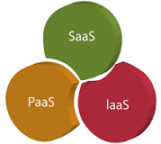
What are the uses of cloud service models?
It provides web software and apps to complete business tasks.
It provides runtime environments and deployment tools for applications.
It provides software as a service to the end-users.
Deployment Model

Slide 5
IAAS
IAAS: Infrastructure As A Service (IAAS) is means of delivering computing infrastructure as on-demand services.
It is one of the three fundamental cloud service models.
It allows dynamic scaling and the resources are distributed as a service.

Slide 6
IaaS Pros, Cons and Use Cases

Slide 7
Pros of IaaS include:
Cost efficient
Scalability

Slide 8
Cons of IaaS include
Security
Technical issues

Slide 9
Use cases for IaaS include:
Website hosting: Organizations can save money using IaaS tools rather than traditional web hosting to run their websites.
Deploying software: Companies can use IaaS to deploy and run common business software, such as SAP and Salesforce.
Testing and development: IaaS enables developers to more easily scale up development and test environments.

Slide 10
PaaS
Platform As A Service (PAAS) is a cloud delivery model for applications composed of services managed by a third party.
It provides elastic scaling of your application which allows developers to build applications and services over the internet and the deployment models include public, private and hybrid.
The tools which are provided are used by developers. PAAS is also known as Application PAAS.
It helps us to organize and maintain useful applications and services. It has a well-equipped management system and is less expensive compared to IAAS.

Slide 11
PaaS Pros, Cons and Use Cases

Slide 12
Pros of PaaS include
Simplicity, convenience
Faster Development

Slide 13
Cons of PaaS include:
Lack of scalability
Vendor lock-in

Slide 14

PaaS use cases include:
API development: Developers can use PaaS to develop, run, manage and secure APIs and micro services .
Internet of things (IoT): PaaS supports a variety of application environments, tools and programming languages used for IoT deployments.
Business analytics: Companies can use PaaS tools to analyze their data to uncover business insights for better decision-making.

Slide 15

SaaS
SAAS services are used for the development and deployment of modern applications.
It allows software and its functions to be accessed from anywhere with good internet connection device and a browser.
An application is hosted centrally and also provides access to multiple users across various locations via the internet.

Slide 16
SaaS Pros, Cons and Use Cases
Pros of using SaaS include:
Easy to access and use
Scalability

Slide 17
Cons of using SaaS include
Lack of control
Issue with integrations

Slide 18
SaaS use cases
include enterprise applications for services
such as email,
sales management,
customer relationship management (CRM),
financial management,
human resource management (HRM),
billing and collaboration.

Slide 19
How Do the 3 Cloud Computing Service Models Differ?
The three cloud service models mainly differ in what they offer out of the box.
SaaS is cloud-based software that companies can buy from cloud providers and use.
PaaS helps developers build customized applications via an application programming interface (API) that can be delivered over the cloud.
IaaS helps companies build the infrastructure of cloud-based services, including software, content or e-commerce websites to sell physical products.

Slide 20

Cont….
Companies that use SaaS don't have to manage their data use or maintain their applications.
With PaaS and IaaS, however, users must manage their own data use and applications.
SaaS and PaaS providers manage organizations' operating systems, but IaaS users must handle their own operating systems.

Slide 21
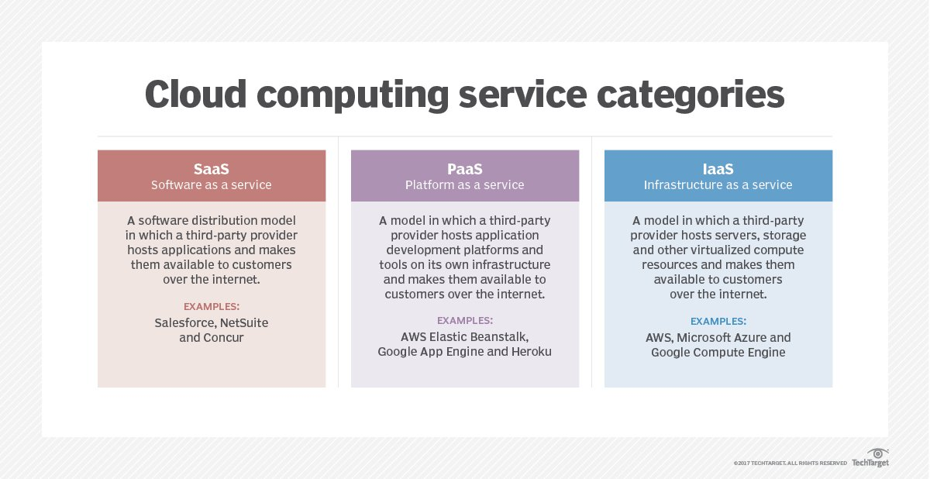

Slide 22

Comparison of Deployment Model

Slide 23
Difference between IAAS, PAAS and SAAS :
Basis Of | IAAS | PAAS | SAAS
Stands for | Infrastructure as a service. | Platform as a service. | Software as a service.
Uses | IAAS is used by network architects. | PAAS is used by developers. | SAAS is used by the end user.
Access | IAAS gives access to the resources like virtual machines and virtual storage. | PAAS gives access to run time environment to deployment and development tools for application. | SAAS gives access to the end user.

Slide 24
Model | It is a service model that provides virtualized computing resources over the internet. | It is a cloud computing model that delivers tools that are used for the development of applications. | It is a service model in cloud computing that hosts software to make it available to clients.
Technical understanding. | It requires technical knowledge. | Some knowledge is required for the basic setup. | There is no requirement about technicalities company handles everything.
Popularity | It is popular among developers and researchers. | It is popular among developers who focus on the development of apps and scripts. | It is popular among consumers and companies, such as file sharing, email, and networking.

Slide 25
Percentage rise | It has around a 12% increment. | It has around 32% increment. | It has about a 27 % rise in the cloud computing model.
Usage | Used by the skilled developer to develop unique applications. | Used by mid-level developers to build applications. | Used among the users of entertainment.
Cloud services. | Amazon Web Services, sun, vCloud Express. | Facebook, and Google search engine. | MS Office web, Facebook and Google Apps.

Slide 26
Enterprise services. | AWS virtual private cloud. | Microsoft Azure. | IBM cloud analysis.
Outsourced cloud services. | Salesforce | Force.com, Gigaspaces. | AWS, Terremark
User Controls | Operating System, Runtime, Middleware, and Application data | Data of the application | Nothing
Others | It is highly scalable and flexible. | It is highly scalable to suit the different businesses according to resources. | It is highly scalable to suit the small, mid and enterprise level business

Slide 27
How to Choose Between SaaS vs. PaaS vs. IaaS
The size of your organization can help determine which cloud model to use. A few recommendations include:
Small/medium/large companies with limited resources: SaaS
Businesses can save money with software as a service because they don't have to design and develop the software themselves.
It makes sense for companies to use SaaS products that meet their business requirements because they can quickly be more productive.

Slide 28
Medium/large organizations with some resources: PaaS
Medium and large businesses with IT departments should consider platform as a service as an option.
particularly if they need customized applications that can more easily integrate with their workflows and technologies.

Slide 29

Medium/large enterprises with moderate resources : IaaS
Medium and large businesses that have the necessary IT resources should think about using infrastructure as a service.
The almost complete control that IaaS provides means they can create highly customized technology stacks that meet an organization's specific business requirements.
IaaS also makes it easy to adapt the technology if business requirements change.

Slide 30
Although similar, choosing among
software as a service,
platform as a service and
infrastructure as a service

Slide 31
THANK YOU

